Slide 1
BASIC ELECTRONICS

Slide 2
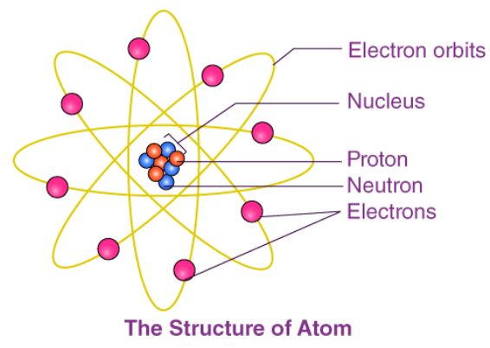
UNIT-1
Atomic Structure
What Is Atomic Structure?
The atomic structure of an element refers to the constitution of its nucleus and the arrangement of the electrons around it. Primarily, the atomic structure of matter is made up of protons, electrons and neutrons.
The protons and neutrons make up the nucleus of the atom, which is surrounded by the electrons belonging to the atom. The atomic number of an element describes the total number of protons in its nucleus.

Slide 3
Neutral atoms have equal numbers of protons and electrons. However, atoms may gain or lose electrons in order to increase their stability, and the resulting charged entity is called an ion.
Atoms of different elements have different atomic structures because they contain different numbers of protons and electrons. This is the reason for the unique characteristics of different elements.

Slide 4
Subatomic Particles
Protons
Protons are positively charged subatomic particles. The charge of a proton is 1e, which corresponds to approximately 1.602 × 10-19
The mass of a proton is approximately 1.672 × 10-24
Protons are over 1800 times heavier than electrons.
The total number of protons in the atoms of an element is always equal to the atomic number of the element.
Neutrons
The mass of a neutron is almost the same as that of a proton, i.e., 1.674×10-24
Neutrons are electrically neutral particles and carry no charge.
Different isotopes of an element have the same number of protons but vary in the number of neutrons present in their respective nuclei.
Electrons
The charge of an electron is -1e, which approximates to -1.602 × 10-19
The mass of an electron is approximately 9.1 × 10-31.
Due to the relatively negligible mass of electrons, they are ignored when calculating the mass of an atom.

Slide 5
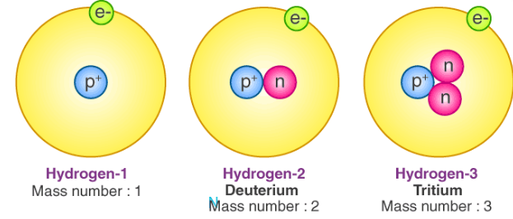
Atomic Structure of Isotopes
Nucleons are the components of the nucleus of an atom. A nucleon can either be a proton or a neutron. Each element has a unique number of protons in it, which is described by its unique atomic number. However, several atomic structures of an element can exist, which differ in the total number of nucleons.
These variants of elements having a different nucleon number (also known as the mass number) are called isotopes of the element. Therefore, the isotopes of an element have the same number of protons but differ in the number of neutrons.
The atomic structure of an isotope is described with the help of the chemical symbol of the element, the atomic number of the element and the mass number of the isotope. For example, there exist three known naturally occurring isotopes of hydrogen, namely, protium, deuterium and tritium. The atomic structures of these hydrogen isotopes are illustrated below.

Slide 6
The isotopes of an element vary in stability. The half-lives of isotopes also differ. However, they generally have similar chemical behaviour owing to the fact that they hold the same electronic structures.
Atomic Structures of Some Elements
The structure of an atom of an element can be simply represented via the total number of protons, electrons and neutrons present in it. The atomic structures of a few elements are illustrated below.
Hydrogen
The most abundant isotope of hydrogen on the planet Earth is protium. The atomic number and the mass number of this isotope are 1 and 1, respectively.
Structure of Hydrogen Atom: This implies that it contains one proton, one electron and no neutrons (Total number of neutrons = Mass number – Atomic number)
Carbon
Carbon has two stable isotopes – 12C and 13C. Of these isotopes, 12C has an abundance of 98.9%. It contains 6 protons, 6 electrons and 6 neutrons.
Structure of Carbon Atom: The electrons are distributed into two shells, and the outermost shell (valence shell) has four electrons. The tetravalency of carbon enables it to form a variety of chemical bonds with various elements.

Slide 7
Oxygen
There exist three stable isotopes of oxygen – 18O, 17O and 16O. However, oxygen-16 is the most abundant isotope.
Structure of Oxygen Atom: Since the atomic number of this isotope is 8 and the mass number is 16, it consists of 8 protons and 8 neutrons. 6 out of the 8 electrons in an oxygen atom lie in the valence shell.
Bohr’s Atomic Theory
Neils Bohr put forth his model of the atom in the year 1915. This is the most widely used atomic model to describe the atomic structure of an element which is based on Planck’s theory of quantization.
Postulates:
The electrons inside atoms are placed in discrete orbits called “stationery orbits”.
The energy levels of these shells can be represented via quantum numbers.
Electrons can jump to higher levels by absorbing energy and move to lower energy levels by losing or emitting their energy.
As long as an electron stays in its own stationery, there will be no absorption or emission of energy.
Electrons revolve around the nucleus in these stationary orbits only.
The energy of the stationary orbits is quantised.

Slide 8
Limitations of Bohr’s Atomic Theory:
Bohr’s atomic structure works only for single electron species such as H, He+, Li2+, Be3+, ….
When the emission spectrum of hydrogen was observed under a more accurate spectrometer, each line spectrum was seen to be a combination of a number of smaller discrete lines.
Both Stark and Zeeman’s effects couldn’t be explained using Bohr’s theory.
Heisenberg’s uncertainty principle: Heisenberg stated that no two conjugate physical quantities could be measured simultaneously with 100% accuracy. There will always be some error or uncertainty in the measurement.
Drawback: Position and momentum are two such conjugate quantities that were measured accurately by Bohr (theoretically).
Stark effect: Phenomenon of deflection of electrons in the presence of an electric field.
Zeeman effect: Phenomenon of deflection of electrons in the presence of a magnetic field.

Slide 9
Dual Nature of Matter
The electrons, which were treated to be particles, and the evidence of the photoelectric effect show they also have a wave nature. This was proved by Thomas Young with the help of his double-slit experiment.
De-Broglie concluded that since nature is symmetrical, so should light or any other matter wave be.
Quantum Numbers
Principal Quantum Number (n): It denotes the orbital number or shell number of an electron.
Azimuthal Quantum Numbers (l): It denotes the orbital (sub-orbit) of the electron.
Magnetic Quantum Number: It denotes the number of energy states in each orbit.
Spin Quantum number(s): It denotes the direction of spin, S = -½ = Anticlockwise and ½ = Clockwise.

Slide 10
Electronic Configuration of an Atom
The electrons have to be filled in the s, p, d and f in accordance with the following rule.
1. Aufbau’s principle: The filling of electrons should take place in accordance with the ascending order of energy of orbitals.
Lower energy orbital should be filled first, and higher energy levels.
The energy of orbital α(p + l) value it two orbitals have the same (n + l) value, E α n
Ascending order of energy 1s, 2s, 2p, 3s, 3p, 4s, 3d, . . .
2. Pauli’s exclusion principle: No two electrons can have all four quantum numbers to be the same, or if two electrons have to be placed in an energy state, they should be placed with opposite spies.
3. Hund’s rule of maximum multiplicity: In the case of filling degenerate (same energy) orbitals, all the degenerate orbitals have to be singly filled first, and then, only pairing has to happen

Slide 11
Semiconductors
What Are Semiconductors?
Semiconductors are materials which have a conductivity between conductors (generally metals) and non-conductors or insulators (such as ceramics). Semiconductors can be compounds, such as gallium arsenide, or pure elements, such as germanium or silicon. Physics explains the theories, properties and mathematical approach related to semiconductors.
Examples of Semiconductors
Gallium arsenide, germanium and silicon are some of the most commonly used semiconductors. Silicon is used in electronic circuit fabrication, and gallium arsenide is used in solar cells, laser diodes, etc.

Slide 12
Holes and Electrons in Semiconductors
Holes and electrons are the types of charge carriers accountable for the flow of current in semiconductors. Holes (valence electrons) are the positively charged electric charge carrier, whereas electrons are the negatively charged particles. Both electrons and holes are equal in magnitude but opposite in polarity.
Mobility of Electrons and Holes
In a semiconductor, the mobility of electrons is higher than that of the holes. It is mainly because of their different band structures and scattering mechanisms.
Electrons travel in the conduction band, whereas holes travel in the valence band. When an electric field is applied, holes cannot move as freely as electrons due to their restricted movement. The elevation of electrons from their inner shells to higher shells results in the creation of holes in semiconductors. Since the holes experience stronger atomic force by the nucleus than electrons, holes have lower mobility.
The mobility of a particle in a semiconductor is more, if
The effective mass of particles is lesser
The time between scattering events is more
For intrinsic silicon at 300 K, the mobility of electrons is 1500 cm2 (V∙s)-1, and the mobility of holes is 475 cm2 (V∙s)-1.

Slide 13
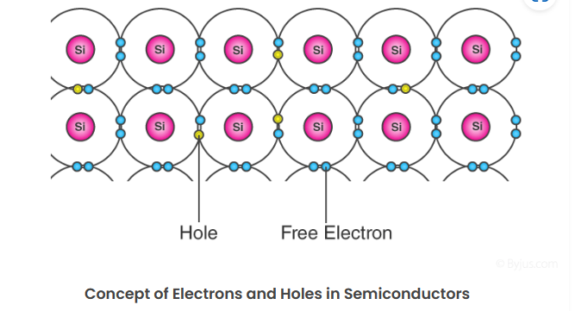
The bond model of electrons in silicon of valency 4 is shown below. Here, when one of the free electrons (blue dots) leaves the lattice position, it creates a hole (grey dots). This hole thus created takes the opposite charge of the electron and can be imagined as positive charge carriers moving in the lattice.

Slide 14
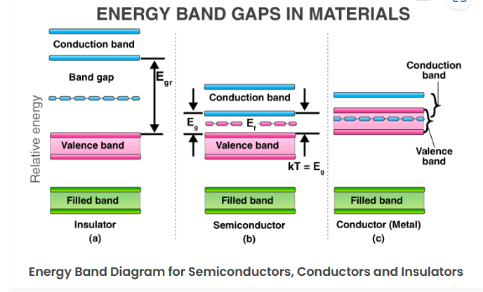
Band Theory of Semiconductors
The introduction of band theory happened during the quantum revolution in science. Walter Heitler and Fritz London discovered the energy bands.
We know that the electrons in an atom are present at different energy levels. When we try to assemble a lattice of a solid with N atoms, each level of an atom must split into N levels in the solid. This splitting of sharp and tightly packed energy levels forms Energy Bands. The gap between adjacent bands representing a range of energies that possess no electron is called a Band Gap.

Slide 15
Conduction Band and Valence Band in Semiconductors
Valence Band
The energy band involving the energy levels of valence electrons is known as the valence band. It is the highest occupied energy band. When compared with insulators, the band gap in semiconductors is smaller. It allows the electrons in the valence band to jump into the conduction band on receiving any external energy.
Conduction Band
It is the lowest, unoccupied band that includes the energy levels of positive (holes) or negative (free electrons) charge carriers. It has conducting electrons resulting in the flow of current. The conduction band possess a high energy level and is generally empty. The conduction band in semiconductors accepts the electrons from the valence band.
What Is the Fermi Level in Semiconductors?
The Fermi level (denoted by EF) is present between the valence and conduction bands. It is the highest occupied molecular orbital at absolute zero. The charge carriers in this state have their own quantum states and generally do not interact with each other. When the temperature rises above absolute zero, these charge carriers will begin to occupy states above the Fermi level.
In a p-type semiconductor, there is an increase in the density of unfilled states. Thus, accommodating more electrons at the lower energy levels. However, in an n-type semiconductor, the density of states increases, therefore, accommodating more electrons at higher energy levels.

Slide 16
Properties of Semiconductors
Semiconductors can conduct electricity under preferable conditions or circumstances. This unique property makes it an excellent material to conduct electricity in a controlled manner as required.
Unlike conductors, the charge carriers in semiconductors arise only because of external energy (thermal agitation). It causes a certain number of valence electrons to cross the energy gap and jump into the conduction band, leaving an equal amount of unoccupied energy states, i.e., holes. The conduction due to electrons and holes is equally important.
Resistivity: 10-5 to 106 Ωm
Conductivity: 105 to 10-6 mho/m
Temperature coefficient of resistance: Negative
Current flow: Due to electrons and holes

Slide 17
Why Does the Resistivity of Semiconductors Go Down with Temperature?
The difference in resistivity between conductors and semiconductors is due to their difference in charge carrier density.
The resistivity of semiconductors decreases with temperature because the number of charge carriers increases rapidly with an increase in temperature, making the fractional change, i.e., the temperature coefficient negative.
Some Important Properties of Semiconductors
Semiconductors act like insulators at zero Kelvin.
On increasing the temperature, they work as conductors.
Due to their exceptional electrical properties, semiconductors can be modified by doping to make semiconductor devices suitable for energy conversion, switches and amplifiers.
Lesser power losses.
Semiconductors are smaller in size and possess less weight.
Their resistivity is higher than conductors but lesser than insulators.
The resistance of semiconductor materials decreases with an increase in temperature and vice-versa.

Slide 18

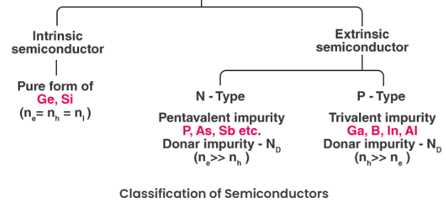
Types of Semiconductors
Semiconductors can be classified as follows:
Intrinsic Semiconductor
Extrinsic Semiconductor

Slide 19
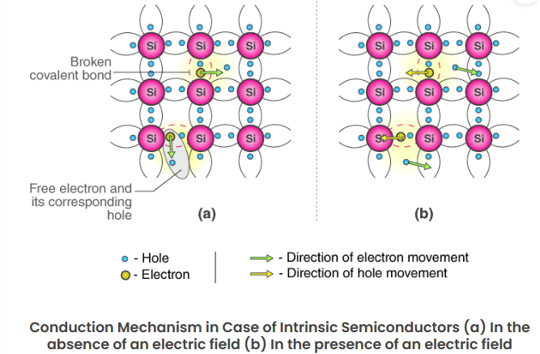
Intrinsic Semiconductor
An intrinsic type of semiconductor material is made to be very pure chemically. It is made up of only a single type of element.
Germanium (Ge) and silicon (Si) are the most common types of intrinsic semiconductor elements. They have four valence electrons (tetravalent). They are bound to the atom by a covalent bond at absolute zero temperature.

Slide 20
When the temperature rises due to collisions, few electrons are unbounded and become free to move through the lattice, thus creating an absence in its original position (hole). These free electrons and holes contribute to the conduction of electricity in the semiconductor. The negative and positive charge carriers are equal in number.
The thermal energy is capable of ionising a few atoms in the lattice, and hence, their conductivity is less.
The Lattice of Pure Silicon Semiconductor at Different Temperatures
At absolute zero Kelvin temperature: At this temperature, the covalent bonds are very strong, there are no free electrons, and the semiconductor behaves as a perfect insulator.
Above absolute temperature: With an increase in temperature, a few valence electrons jump into the conduction band, and hence, it behaves like a poor conductor.

Slide 21
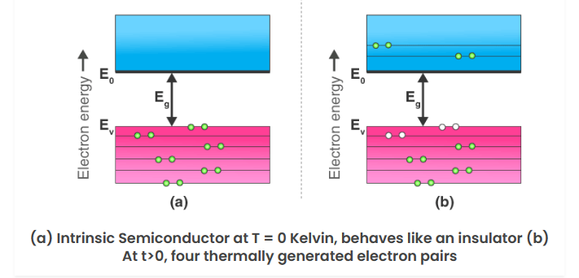
Energy Band Diagram of Intrinsic Semiconductor
The energy band diagram of an intrinsic semiconductor is shown below.
In intrinsic semiconductors, current flows due to the motion of free electrons, as well as holes. The total current is the sum of the electron current Ie due to thermally generated electrons and the hole current Ih.
Total Current (I) = Ie + Ih

Slide 22
For an intrinsic semiconductor, at finite temperature, the probability of electrons existing in a conduction band decreases exponentially with an increasing band gap (Eg).
n = n0e-Eg/2.Kb.T
Where,
Eg = Energy band gap
Kb = Boltzmann’s constants

Slide 23
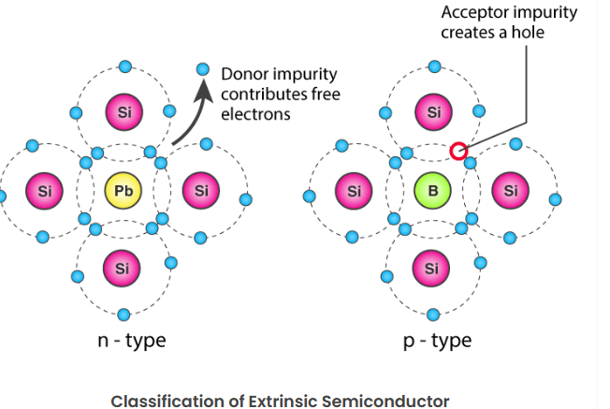
Extrinsic Semiconductor
The conductivity of semiconductors can be greatly improved by introducing a small number of suitable replacement atoms called IMPURITIES. The process of adding impurity atoms to the pure semiconductor is called DOPING. Usually, only 1 atom in 107 is replaced by a dopant atom in the doped semiconductor. An extrinsic semiconductor can be further classified into types:
1.N-type Semiconductor
2.P-type Semiconductor

Slide 24
N-Type Semiconductor
Mainly due to electrons
Entirely neutral
I = Ih and nh >> ne
Majority – Electrons and Minority – Holes
When a pure semiconductor (silicon or germanium) is doped by pentavalent impurity (P, As, Sb, Bi), then four electrons out of five valence electrons bond with the four electrons of Ge or Si.
The fifth electron of the dopant is set free. Thus, the impurity atom donates a free electron for conduction in the lattice and is called a “Donar“.
Since the number of free electrons increases with the addition of an impurity, the negative charge carriers increase. Hence, it is called an n-type semiconductor.
Crystal as a whole is neutral, but the donor atom becomes an immobile positive ion. As conduction is due to a large number of free electrons, the electrons in the n-type semiconductor are the MAJORITY CARRIERS, and holes are the MINORITY CARRIERS.

Slide 25
P-Type Semiconductor
Mainly due to holes
Entirely neutral
I = Ih and nh >> ne
Majority – Holes and Minority – Electrons
When a pure semiconductor is doped with a trivalent impurity (B, Al, In, Ga), then the three valence electrons of the impurity bond with three of the four valence electrons of the semiconductor.
This leaves an absence of electron (hole) in the impurity. These impurity atoms which are ready to accept bonded electrons are called “Acceptors“.
With an increase in the number of impurities, holes (the positive charge carriers) are increased. Hence, it is called a p-type semiconductor.
Crystal, as a whole, is neutral, but the acceptors become an immobile negative ion. As conduction is due to a large number of holes, the holes in the p-type semiconductor are MAJORITY CARRIERS, and electrons are MINORITY CARRIERS.

Slide 26
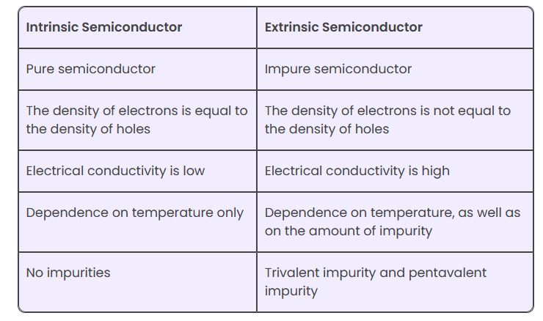
Difference between Intrinsic and Extrinsic Semiconductors

Slide 27
Applications of Semiconductors
Let us now understand the uses of semiconductors in daily life. Semiconductors are used in almost all electronic devices. Without them, our life would be much different.
Their reliability, compactness, low cost and controlled conduction of electricity make them ideal to be used for various purposes in a wide range of components and devices. Transistors, diodes, photosensors, microcontrollers, integrated chips and much more are made up of semiconductors.
Uses of Semiconductors in Everyday Life
Temperature sensors are made with semiconductor devices.
They are used in 3D printing machines
Used in microchips and self-driving cars
Used in calculators, solar plates, computers and other electronic devices.
Transistors and MOSFET used as a switch in electrical circuits are manufactured using semiconductors.

Slide 28
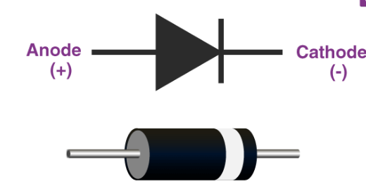
Diodes
A diode is a two-terminal electronic component that conducts electricity primarily in one direction. It has high resistance on one end and low resistance on the other end.
What Is a Diode?
Diodes are used to protect circuits by limiting the voltage and to also transform AC into DC. Semiconductors like silicon and germanium are used to make the most of the diodes. Even though they transmit current in a single direction, the way with which they transmit differs. There are different kinds of diodes and each type has its own applications.
Diode symbol
A standard diode symbol is represented as above. In the above diagram, we can see that there are two terminals that are known as anode and cathode. The arrowhead is the anode that represents the direction of the conventional current flow in the forward biased condition. The other end is the cathode.

Slide 29
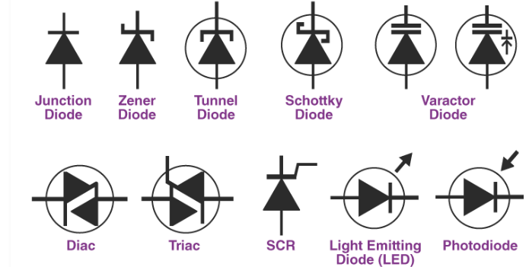
Diode Construction
Diodes can be made of either of the two semiconductor materials, silicon and germanium. When the anode voltage is more positive than the cathode voltage, the diode is said to be forward-biased, and it conducts readily with a relatively low-voltage drop. Likewise, when the cathode voltage is more positive than the anode, the diode is said to be reverse-biased. The arrow in the diode symbol represents the direction of conventional current flow when the diode conducts.
Types of Diodes
Light Emitting Diode
Laser diode
Avalanche diode
Zener diode
Schottky diode
Photodiode
PN junction diode

Slide 30
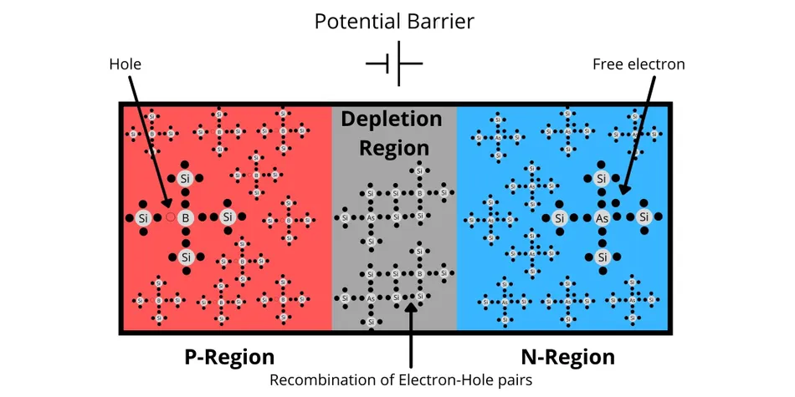
Construction of a p-n junction diode
When one side of a pure semiconductor material like Si or Ge is mixed with a Group 13 or Group 15 element, p-type (positive-type) or n-type (negative-type) semiconductor materials can be formed. Group 13 trivalent impurities like B, Al, Ga, or In form the p-region, whereas pentavalent elements like P, As or Sb, form the n-region. The process is called doping.
After doping, some free electrons from the electron-rich n-type semiconductor area undergo diffusion and bounce over to the hole-rich p-type semiconductor area and form a depletion region or a potential barrier.
Internal Construction of a p-n junction diode showing p-region. n-region and the depletion region

Slide 31
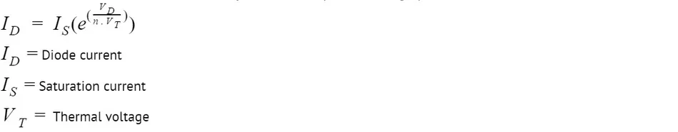
This region does not contain any mobile charges. Charged particles would require an additional force (voltage) to cross this barrier from now on due to a newly created obstruction. For a Silicon (Si) p-n junction, the typical value of this barrier is 0.7 V, and for p-n junctions developed with Germanium (Ge), it's 0.3 V. This voltage is also known as the cut-in voltage.
Before we proceed, we need to define another term that will be the centre of discussion for the next few sections.
Biased Diodes: Application of a fixed DC voltage or current between or through two different but fixed points in an electronic circuit is known as bias or biasing. It is usually done for testing the devices or creating optimal working conditions for the circuit.
The i-v characteristics of a diode closely follow this equation during operation in forward bias:
The same equation can be the basis for plotting the i-v characteristics of a practical diode.
Note: the scale has been compressed and expanded appropriately for the purpose of explanation.

Slide 32
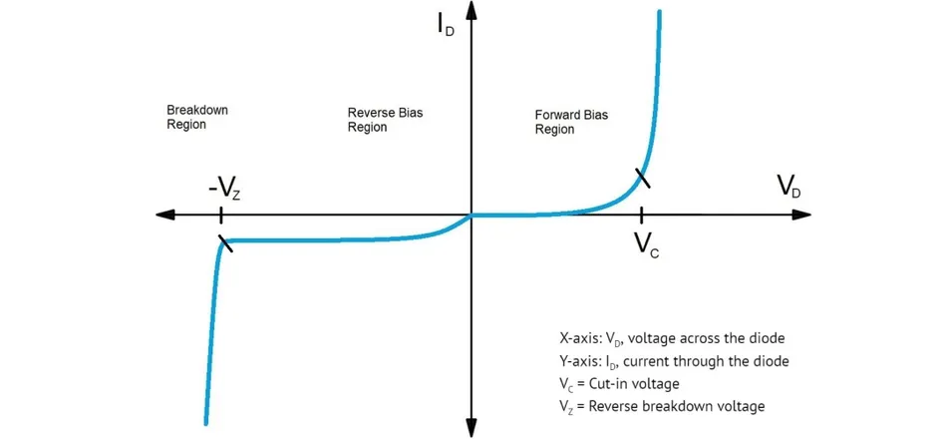
The graph of a practical diode is a deviation from the practical diode characteristics, which require it to switch on and conduct infinite current or switch off and block the current completely without any voltage drop.

Slide 33
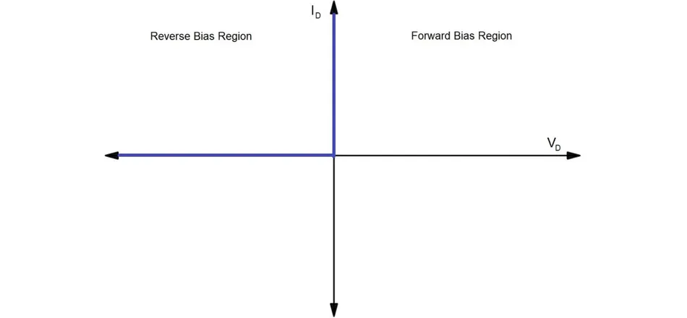
The diodes that exhibit such characteristics are used in simulation and mathematical analysis. They are called ideal diodes and are purely hypothetical.

Slide 34
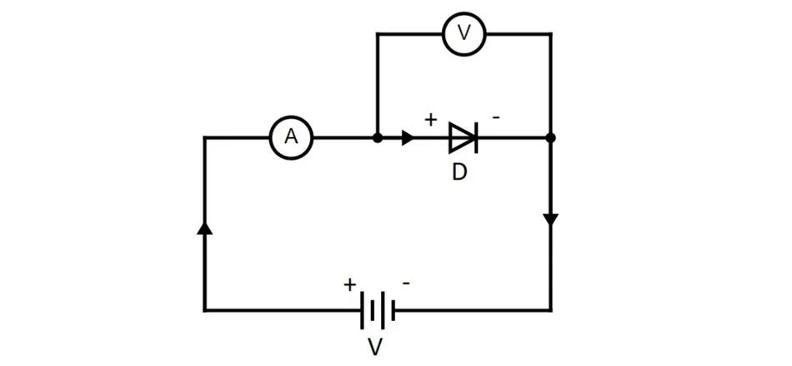
What is Forward Bias?
When the potential applied at the anode (p-side) of a practical diode is higher than the potential applied at the cathode (n-side) by at least the cut-in voltage, the diode is said to be in a forward bias.
It can be clearly seen from the diagram that the positive end of the battery is connected to the positive terminal of the diode, and the negative end of the battery is connected to the negative terminal of the diode.

Slide 35
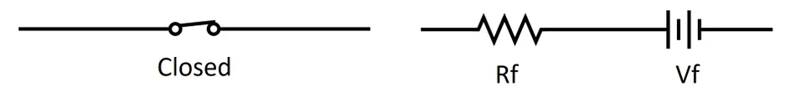
Properties of p-n Junction in Forward Bias
The externally applied voltage in forward bias sets up an electric field in the opposite direction to that of the potential barrier.
As the value of external voltage increases from 0 to cut-in voltage, the width of the potential barrier decreases.
The value of current (leakage current) flowing through the diode is negligibly small in this case and is only due to some electrons that manage to jump across the potential barrier.
When the external voltage is equal to the cut-in voltage, the potential barrier vanishes, thereby breaking the barrier stopping the free movement of current.
As the voltage increases even more, the current rises exponentially until the diode enters into a fully conducting zone.
At this point, a practical diode can be modelled as a series combination of a voltage source in series with a resistor.
The value of the voltage is extremely small and is equal to the cut-in voltage. Resistance, too, is small in magnitude.
An ideal diode in forward bias behaves like a closed switch (left), and a practical diode is equivalent to a small voltage source in series with small resistance

Slide 36
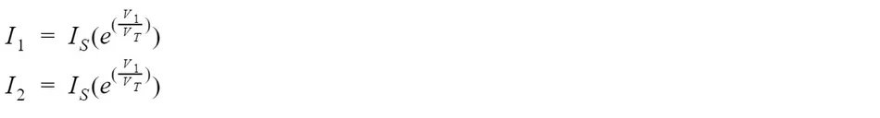
VD = VF + IDRF is the voltage that appears across the diode and depends on the diode current. Since the value of resistance is low, the IDRF term will not change a lot.
Coming to the forward voltage drop VF, let I1 and I2 be the diode currents corresponding to the applied diode voltages V1 and V2 across two diodes.
The ratio of the equations give,
Which can be rewritten as:
The voltage/current difference equation suggests that even for a drastic change in the value of current, the voltage drop across the diode will not change much, which is a simple consequence of a logarithmic relationship.
Hence, during the analysis of a diode in forward bias, the on-state voltage drop can be considered almost constant for a reasonably significant change in diode current.

Slide 37
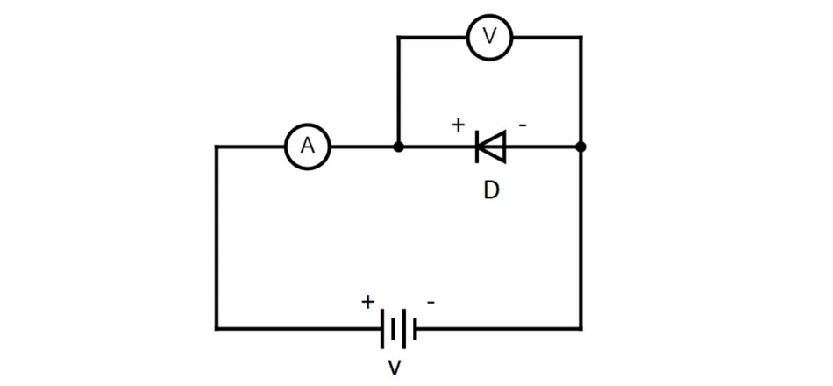
What is Reverse Bias?
When the potential applied at the cathode (n-side) is higher than the potential applied at the anode (p-side), the diode is said to be in a reverse bias.
Reverse Bias Circuit for Diode D
The positive end of the battery is connected to the negative terminal of the p-n junction diode, and the negative end of the battery is connected to the negative terminal of the p-n junction diode.

Slide 38
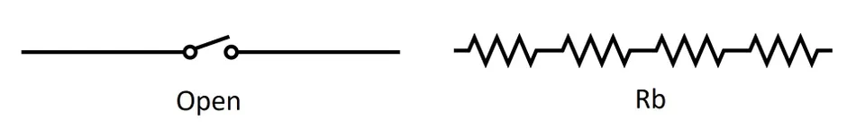
Properties of p-n Junction in Reverse Bias
As the reverse voltage is increased from zero, a small reverse current starts flowing through the semiconductor device. This electric current is due to the minority charge carriers present in the diode.
The value of this reverse current is sufficiently small (compared to the forward current) for us to completely ignore its effect in practical applications.
An ideal diode in forward bias behaves like a closed switch (left), and a practical diode is equivalent to a small voltage source in series with small resistance
Even after increasing the value of voltage by a considerable amount, the value of reverse current isn't affected much and remains almost constant.
This is the reason why it is also known as the saturation current.
Having said that, the value of saturation current can change drastically with temperature.

Slide 39
Reverse Breakdown region
If we keep increasing the value of reverse voltage, the size of the depletion layer will keep growing. This increase in the number of immobile ions causes the electric field in the depletion region to get stronger. The minority charge carriers in the vicinity will get accelerated and can collide with Si atoms, thereby knocking off a valence electron. Once this happens, there will be two free mobile electrons. These electrons further collide with other Si atoms and knock more valence electrons from other atoms kicking off what we can call a chain reaction.
In the absence of a current limiting resistor, the value of current and power dissipation can exceed the safe limits and permanently damage the semiconductor diode. This phenomenon is known as an avalanche breakdown, and the threshold reverse voltage at which this occurs is known as the breakdown voltage.
For a normal diode, operation in such conditions should be avoided. But there are some diodes that are specifically developed for operating in the breakdown region. Such diodes are called Zener diodes or breakdown diodes. We will have a look at the working of the Zener diode in a later section.

Slide 40
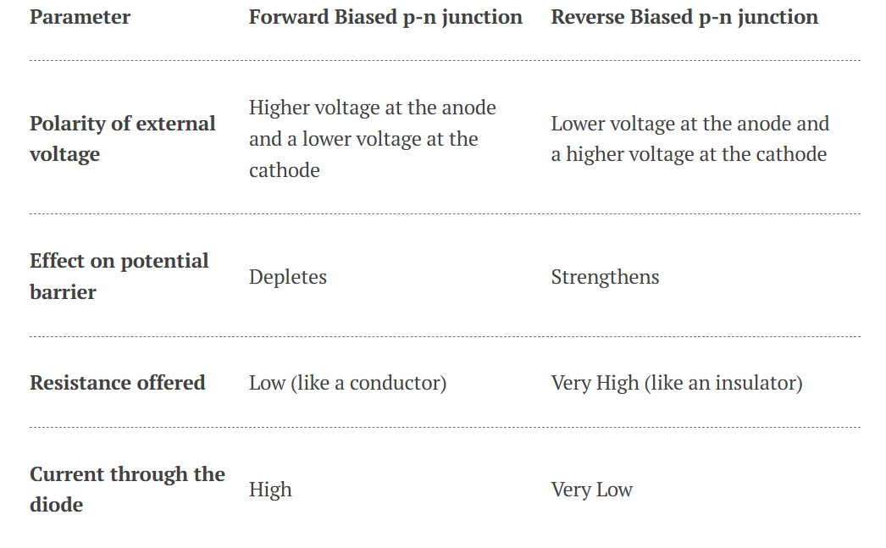
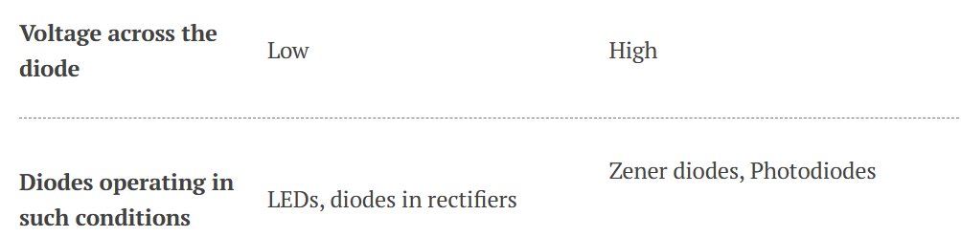
Forward Bias vs Reverse Bias
Here is a table that summarises the comparison between diodes in Forward Bias vs Reverse Bias.

Slide 41
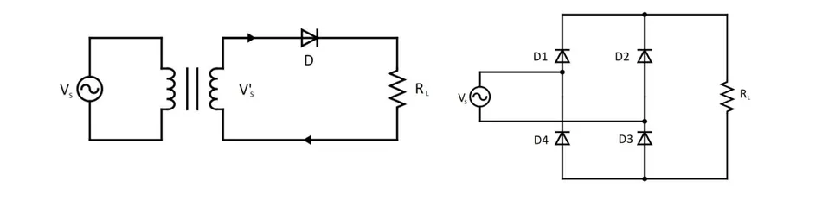
Applications of silicon diodes
Semiconductor diodes find their application in a variety of different circuits that are a part of appliances we use in our day to day life. Diodes can be combined with other electrical/electronic components to develop circuits that can control and convert electrical signals.
Rectifiers
The rectifier is a circuit used to convert AC power into DC directly. It is one of the most important applications of a diode and is the basic building block of power supplies. Rectifiers can be found in chargers, Switch Mode Power Supplies (SMPS), and a lot of other places where a conversion from AC to DC power takes place.
Circuit diagram of a Single Phase Half Bridge Rectifier using a single diode (left) and Single Phase Full Bridge Rectifier using four diodes (right)

Slide 42
The working of the Single Phase Half Bridge Rectifier in the figure above is pretty straightforward. During the positive half cycle, the diode D is forward biased and conducts. During the negative half-cycle, it is reverse biased and blocks the current. Simpler versions of the rectifiers made using a single diode offer very low efficiency and introduce severe harmonics.
In the Single Phase Full Bridge Rectifier circuit, during the positive cycle of the AC voltage source, the current flows through diode D1 into the load Rl and returns through D3. When the source voltage is reversed, the current flows through D2 into Rl and then returns through D4.
A common misconception about diodes or electronics, in general, is that they can not handle high electrical power. But by implementing some constructional and compositional changes, power diodes can be developed, which can easily withstand a voltage in the order of several kilo-volts and current in the range of several kilo-amperes.
The growing interest in the application of electronics to control and convert electrical energy has given birth to an entirely different branch of electrical engineering known as power electronics.

Slide 43
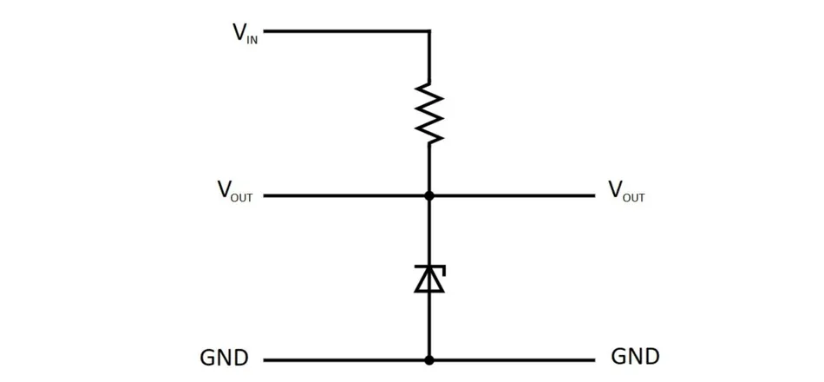
Voltage regulators
Zener diodes are used as voltage regulators in circuits that are intolerant to voltage fluctuations. The component that needs to be protected from voltage changes is connected in parallel with a Zener diode. In the circuit shown below, the voltage across the Zener diode is adjusted such that it always operates in the reverse breakdown region.
Circuit diagram of Zener voltage regulator

Slide 44
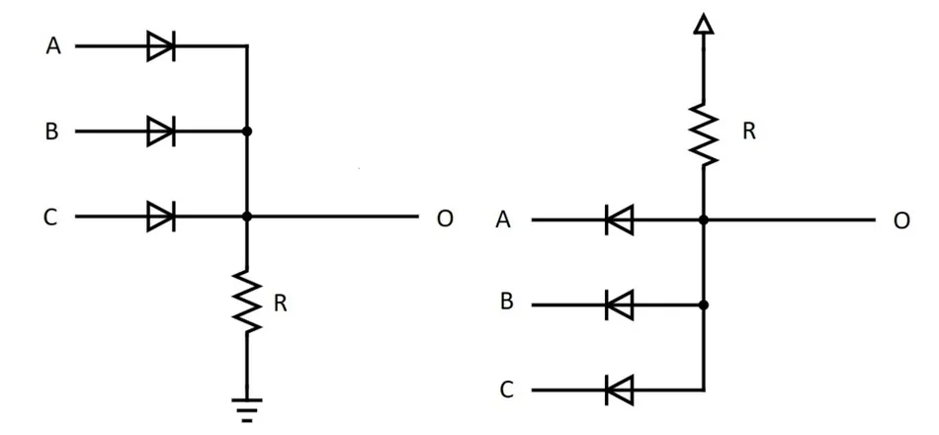
Whenever there is a spike in voltage, the Zener diode bypasses the excess current to maintain the voltage within the safe limits. Zener diodes have largely been replaced by Integrated Circuits (ICs) that offer much higher flexibility lately.
Logic Gates
Everything from calculators to computers is built with digital ICs, and digital ICs are built with digital logic. Logic gates are the basic building blocks of any digital electronic system. Before the introduction of modern logic families like Complementary Metal Oxide Semiconductor (CMOS) technology, diodes were used to implement the logic gates. Here are the circuit diagrams showcasing the implementation of AND and OR logic using diodes:
Realising AND (left) and OR (right) logic gates using diodes and resistors

Slide 45
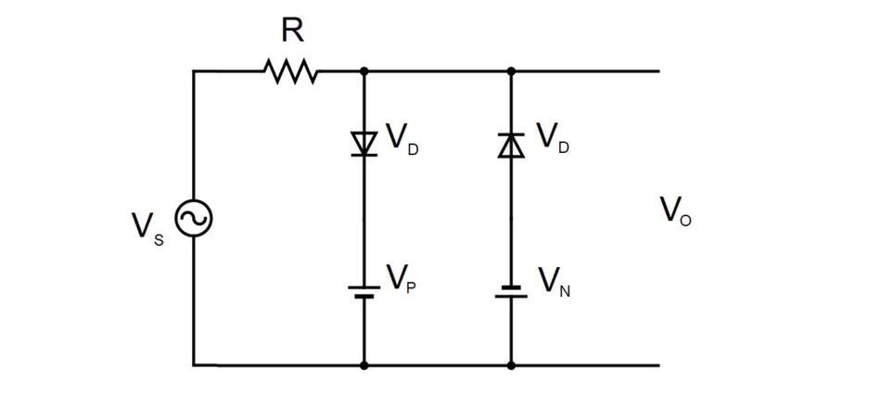
Waveshaping circuits
There are numerous Clipper and Clamper circuits that make use of diodes and other basic electrical elements like resistors, capacitors and inductors to shape the signals. Here is a circuit diagram of a positive clamper. A clamper is a circuit that provides an offset to the input voltage signal.
Positive Clamper circuit
As the AC Voltage source Vs is switched on, the capacitor connected to it starts charging. Once the circuit reaches the steady-state, the capacitor is charged to Vc volts. Since no path is available for the capacitor to discharge, Vc gets added to the source voltage in the subsequent cycles, and the resulting voltage appears at the output.

Slide 46
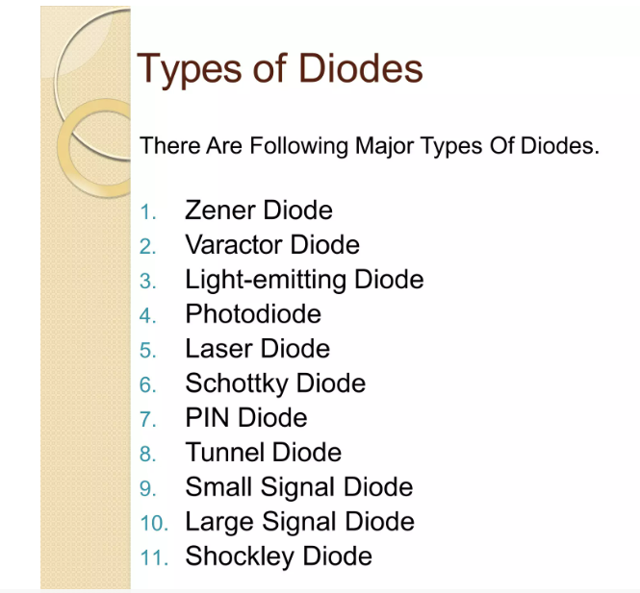

Slide 47
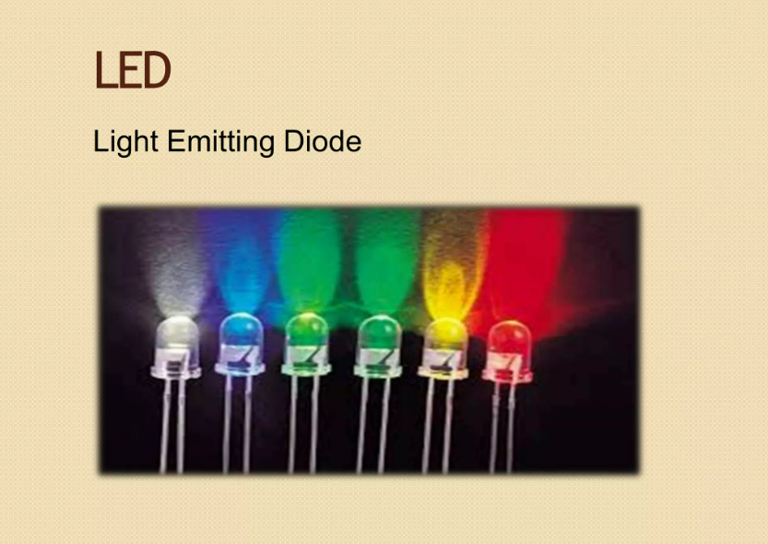

Slide 48
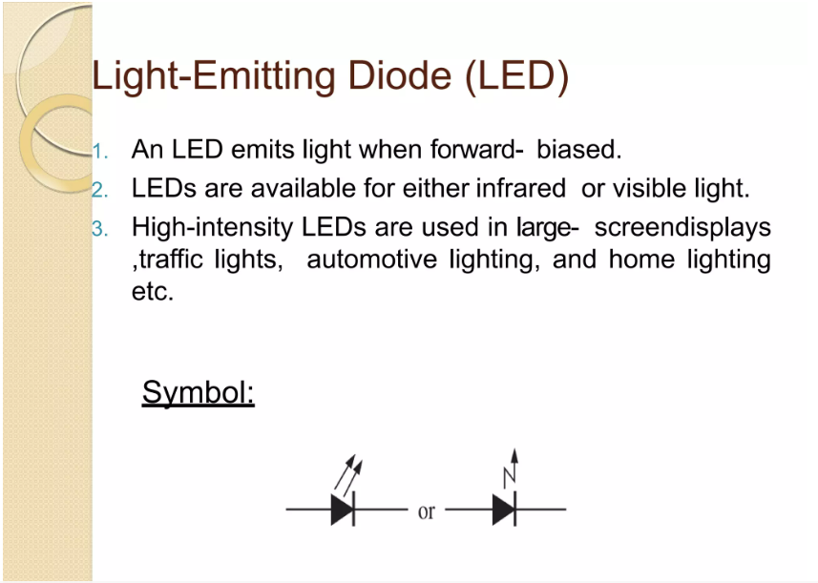

Slide 49
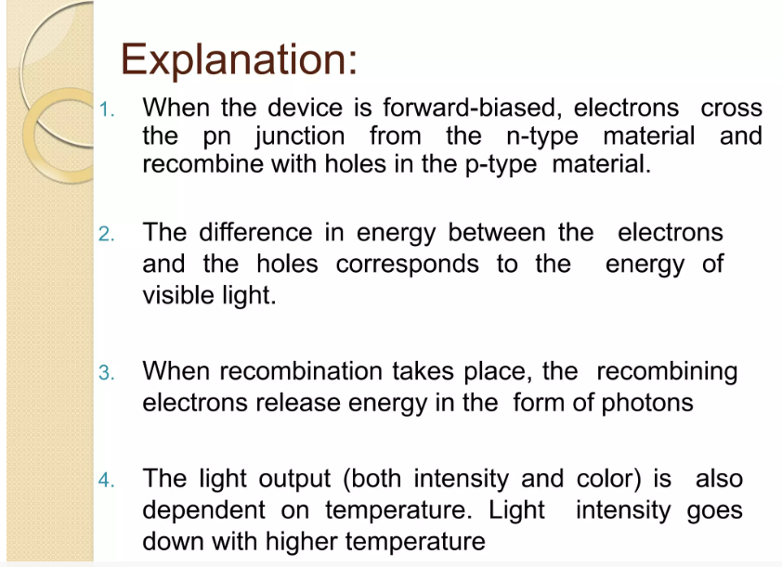

Slide 50
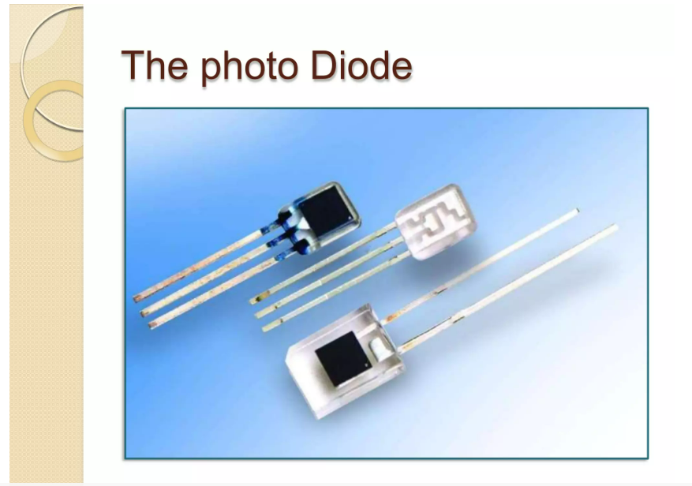

Slide 51
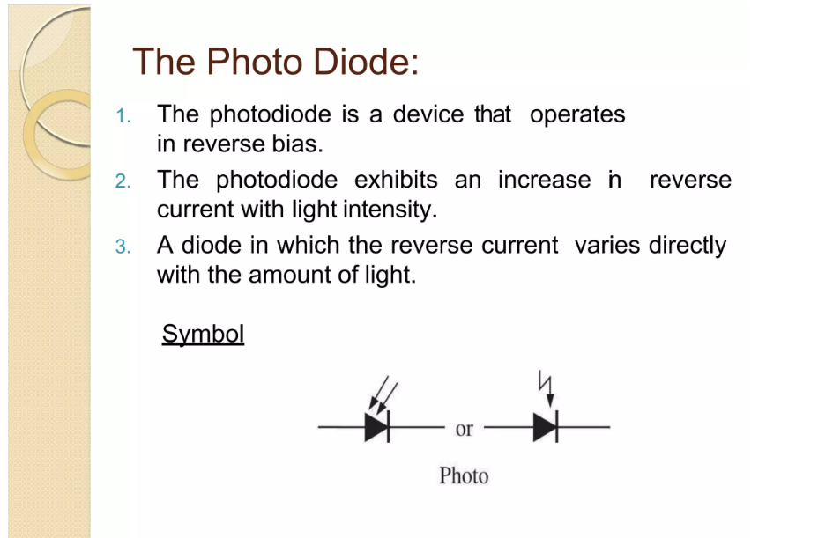

Slide 52
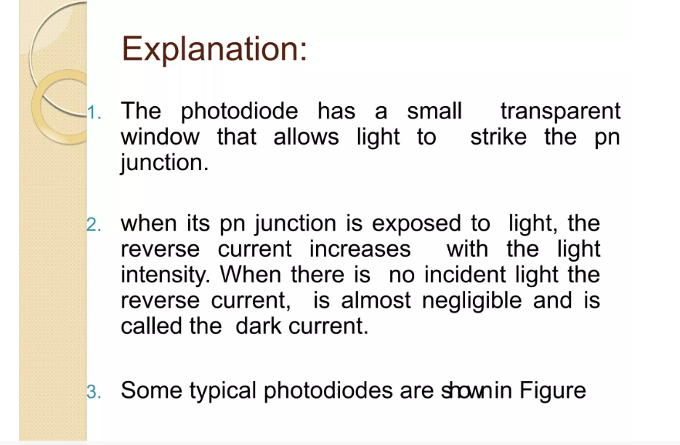

Slide 53
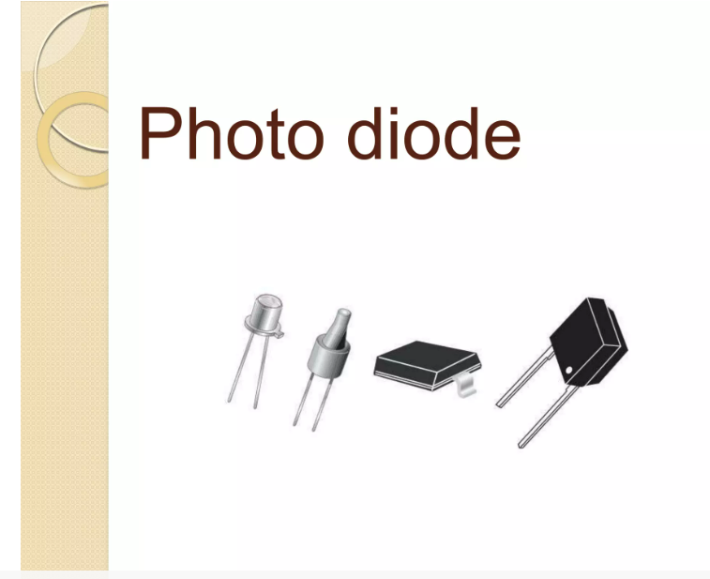

Slide 54
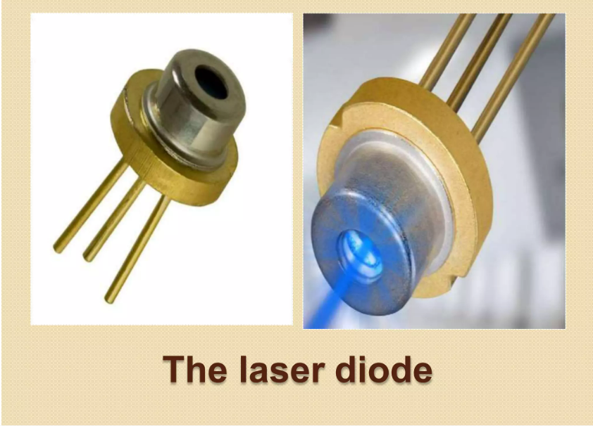

Slide 55
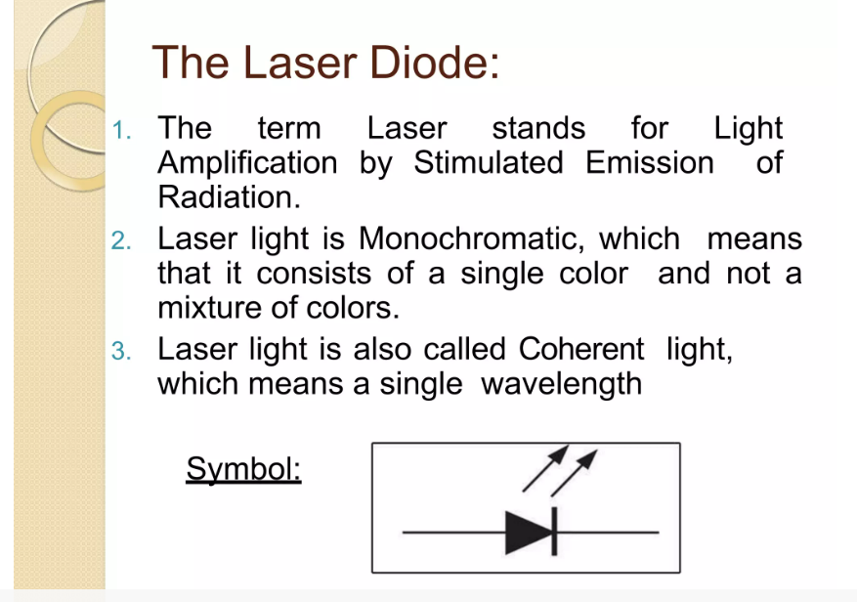

Slide 56
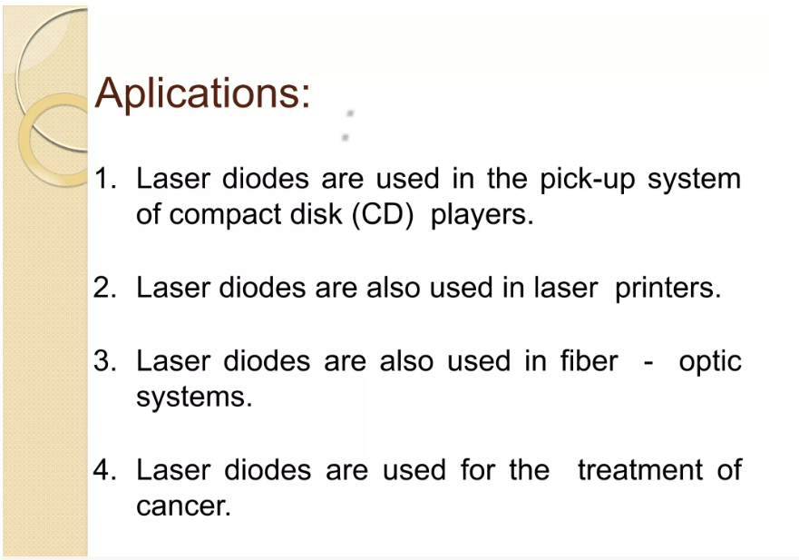

Slide 57
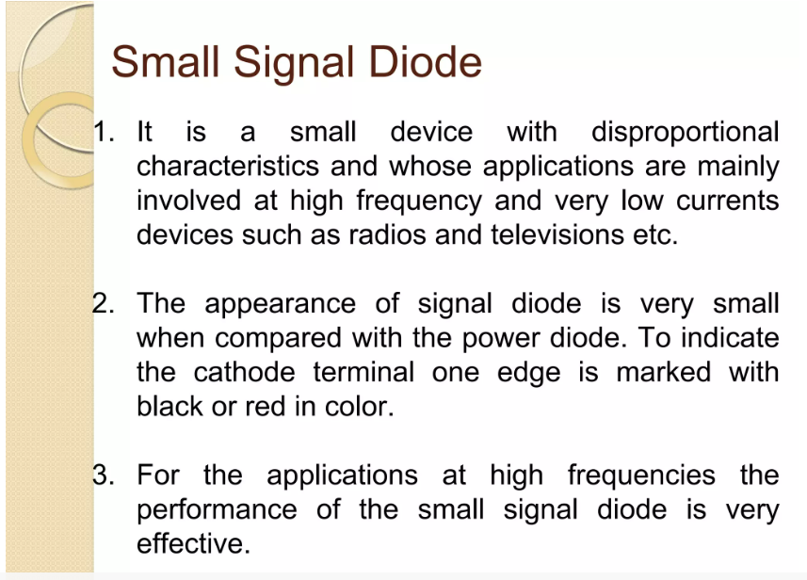

Slide 58
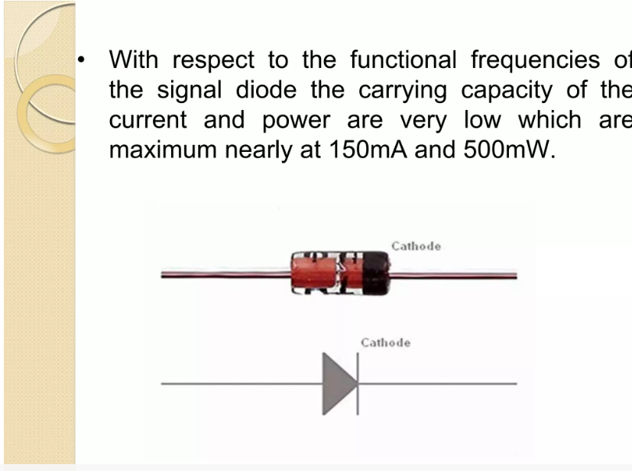

Slide 59
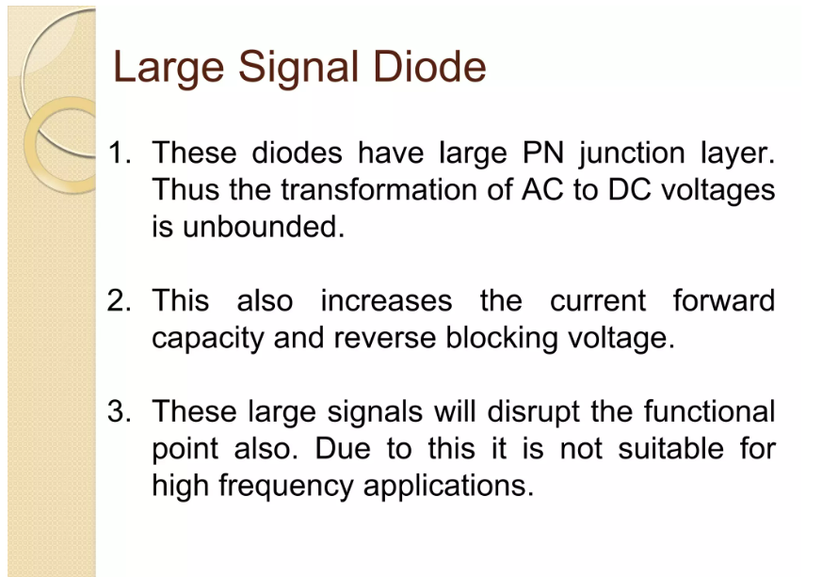

Slide 60
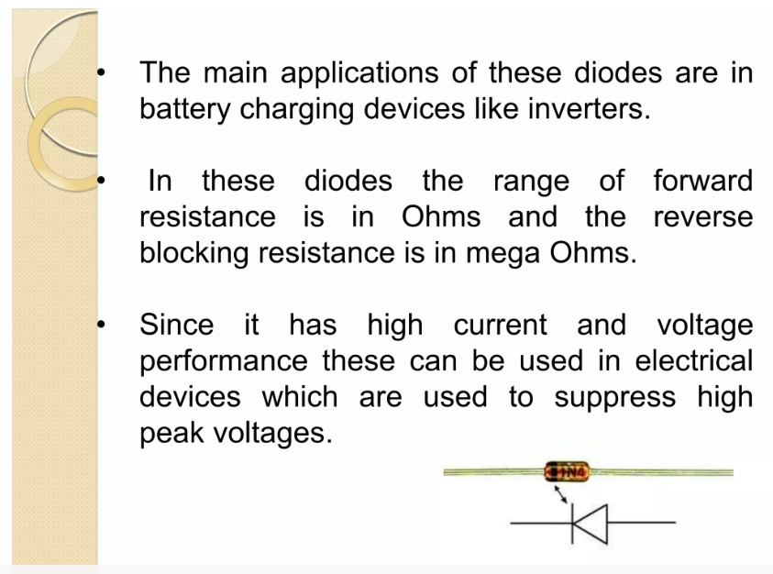

Slide 61
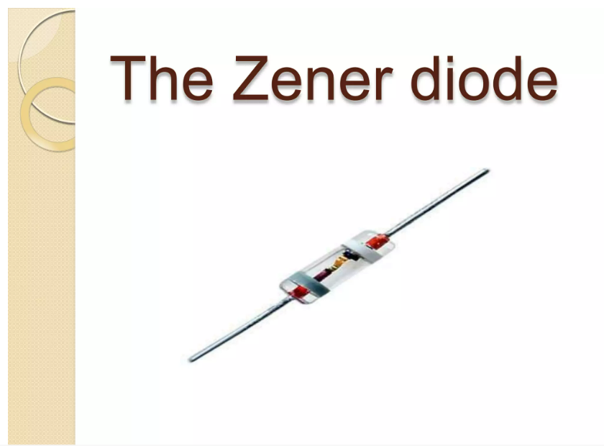

Slide 62
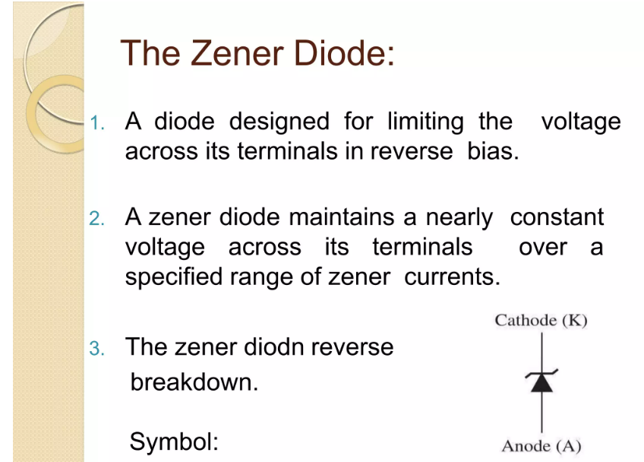

Slide 63
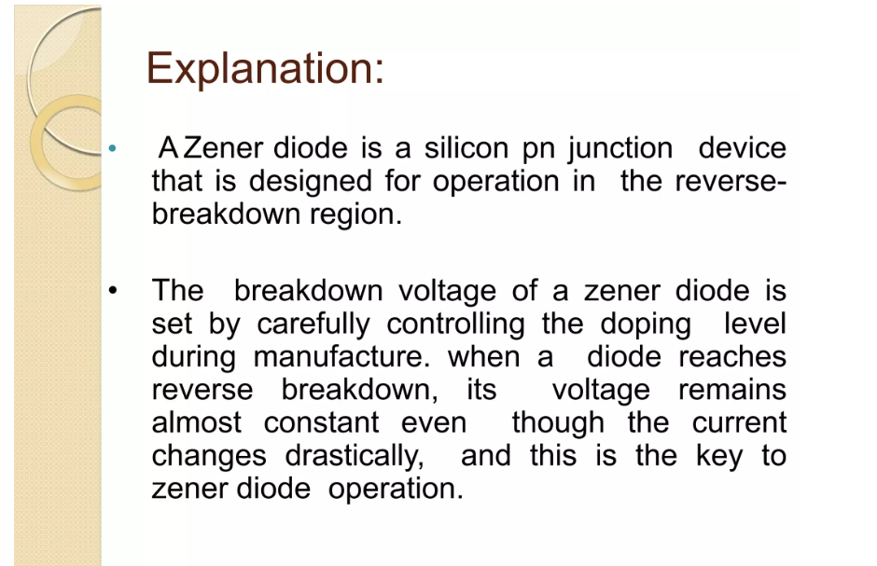

Slide 64
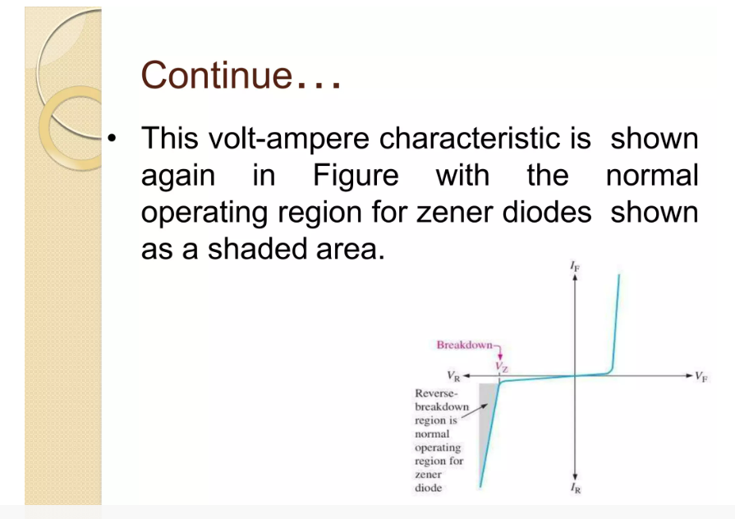

Slide 65
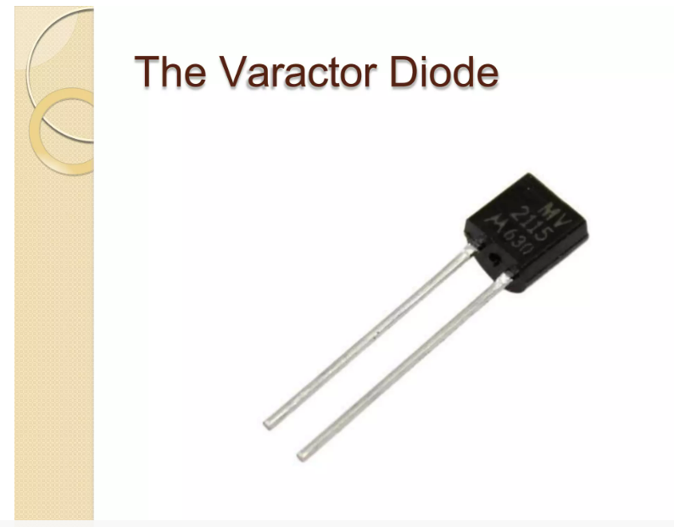

Slide 66
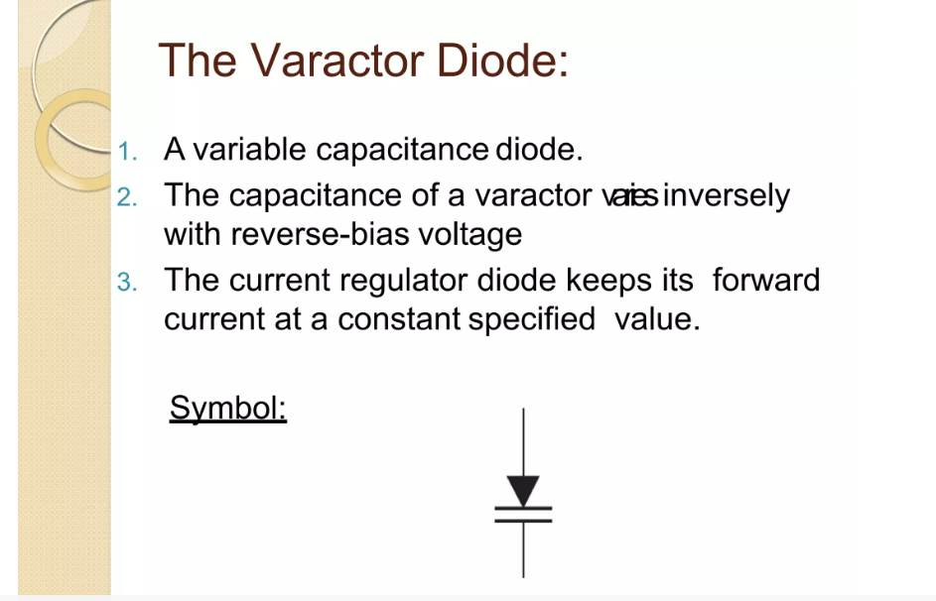

Slide 67
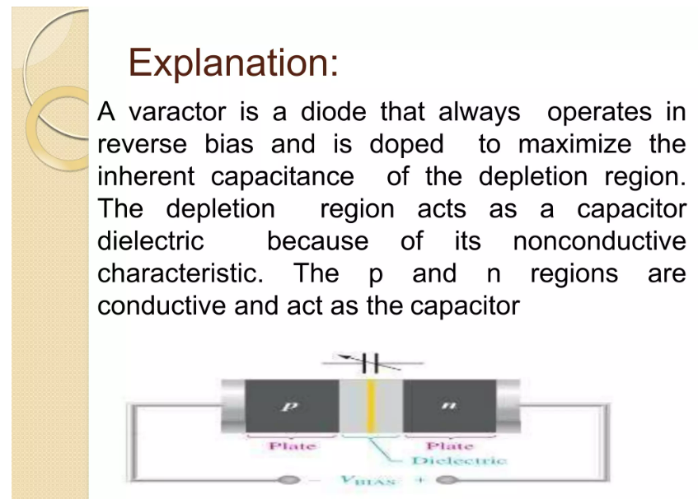

Slide 68
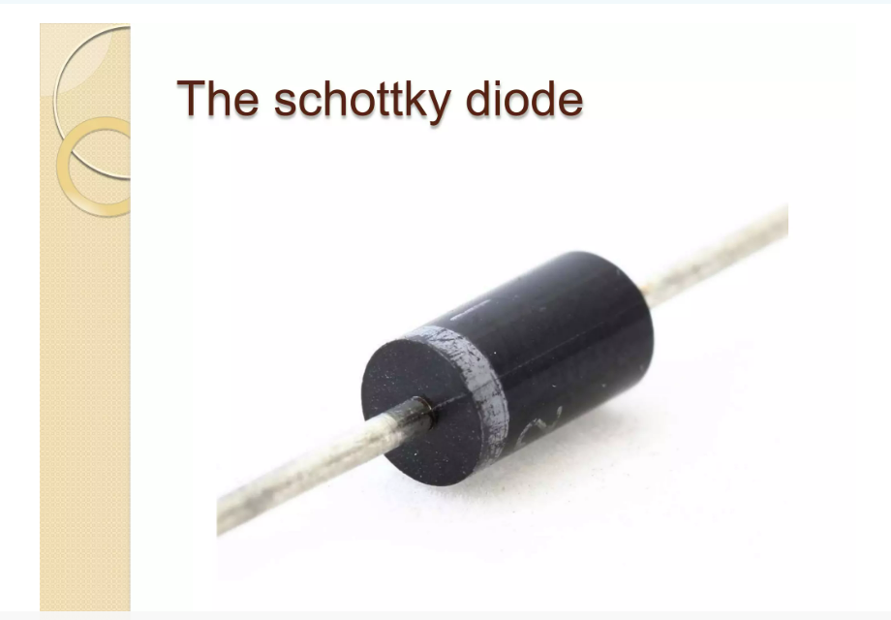

Slide 69
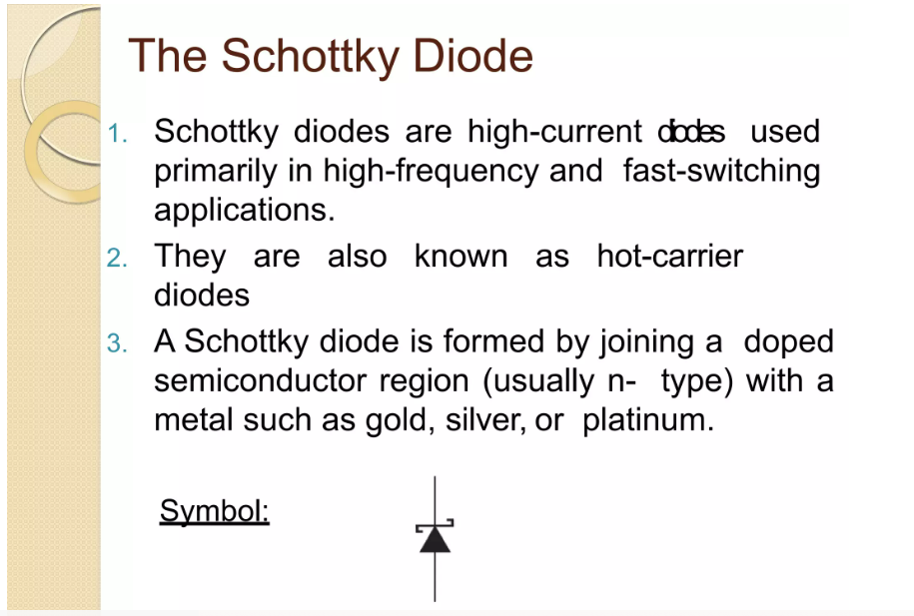

Slide 70


Slide 71


Slide 72


Slide 73


Slide 74


Slide 75


Slide 76


Slide 77


Slide 78


Slide 79


Slide 80


Slide 81


Slide 82


Slide 83


Slide 84


Slide 85


Slide 86


Slide 87


Slide 88


Slide 89


Slide 90


